Slide 1
CREDIT CARD FRAUD DETECTION - CAPSTONE
By
Rushabh Patel | Adul Wahid Mc | Vimal Kant

Slide 2
Index
Objective
Background: Business Understanding
Root Cause Analysis
Steps to make the model
Key Insights
Cost Benefit Analysis
Conclusion

Slide 3
Objective
The number of fraud transactions has increased drastically due to which credit card companies are facing a lot of challenges
With the rise in digital payment channels, the number of fraudulent transactions is also increasing as fraudsters are finding new and different ways to commit such crimes.
Banking fraud poses a significant threat in terms of substantial financial loss, trust, and credibility and is a concerning issue for both banks and customers alike
Objective is to make a Credit Card Fraud Detection Model to generate high revenue with minimal losses

Slide 4
Background: Business understanding
Finex is a leading financial service provider based out of Florida, US.
It offers a wide range of products and business services to customers through different channels, ranging from in-person banking and ATMs to online banking.
Over the last few years, Finex has observed that a significantly large number of unauthorised transactions are being made, due to which the bank has been facing a huge revenue and profitability crisis.
Customers get to know of such unauthorised transactions happening through their cards quite late.
Finex is also not really equipped with the latest financial technologies, and it is becoming difficult for the bank to track these data breaches on time to prevent further losses.

Slide 5
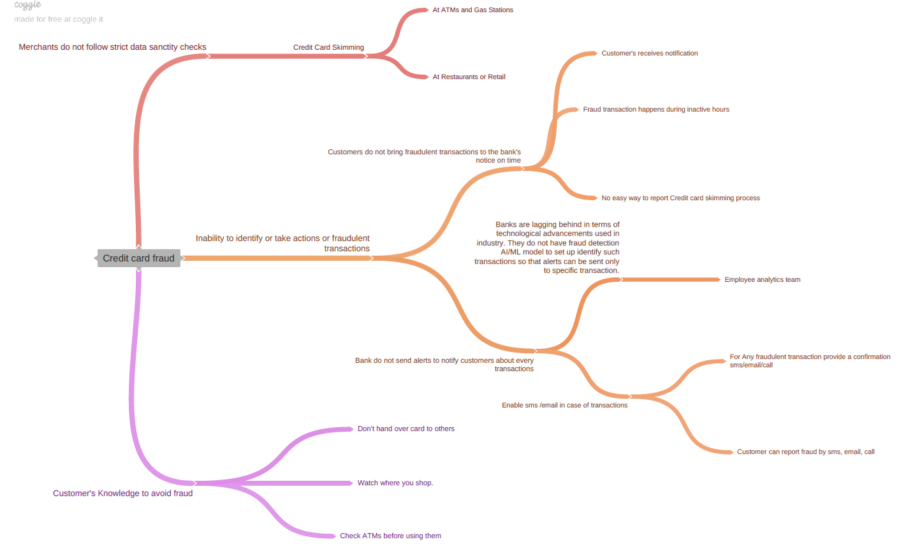
Root cause analysis

Slide 6
Steps to make the model (EDA)
Reading and understanding the data
shape(99999 rows and 226 columns), info, describe, duplicate values check, concat both the data files into fraud_data
Cleaning the data
check the null values
Dropping Unnecessary Columns which are not needed for Analysis
Converting columns to appropriate formats
bifurcation of columns for better understanding
binning on job and state column as having analogous entries

Slide 7
Steps to make the model (Visualization)
Visualization of data
Univariate Analysis
- Numerical
- Categorical
Multivariate Analysis
- Visualising Numerical - Numerical Variables
- Visualising Categorical- Categorical Variables
- Visualising Numerical - Categorical Variables

Slide 8
Steps to make the model(data preparation)
Data preparation
Derive new features
Conducting appropriate exploratory analysis to extract useful INSIGHTS (whether directly useful for business or for eventual modelling/feature engineering).
Cost Benefit Analysis(part 1)
Check Correlation
Drop features which are not seems to be useful for model as correlation is high
Creating Dummy for few variables and using Label encoding for few variables
Splitting the Data into X & y
Test-Train Split
Checking for Class imbalance in Train & Test and treating it
- SMOTE
- ADASYN

Slide 9
Steps to make the model(Modelling)
Model 1: Decision Tree
- Decision Tree (Default Hyperparameters for both SMOTE and ADASYN)
- Decision Tree (Hyperparameter Tuning for SMOTE)
- Model 2: Random Forest
- Random Forest (Default Hyperparameters for both SMOTE and ADASYN)
- Random Forest (Hyperparameters Tuning for SMOTE)
- Model 3: XGBoost
- XGBoost (Default Hyperparameters for both SMOTE and ADASYN)
- XGBoost (Hyperparameters Tuning for SMOTE)

Slide 10
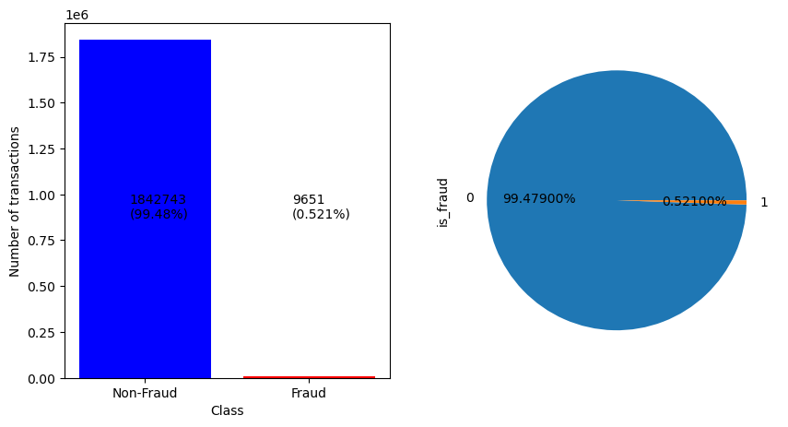
Key insights
In the Original data 99.5% of the transactions were classitifed as not fraud and only 0.5% of the transactions are fraud which was a case of class imbalance which was treated

Slide 11
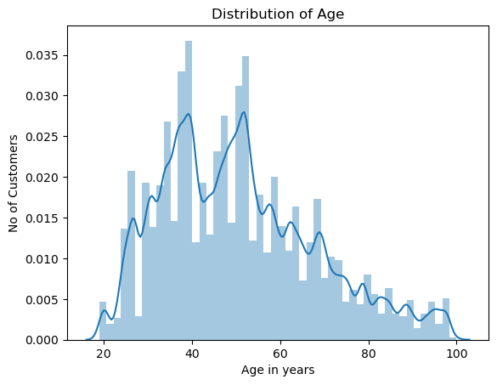
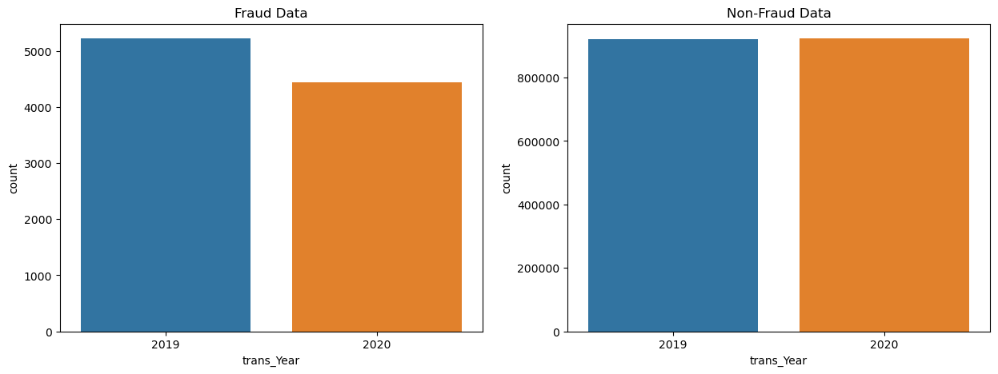
Key insights
- The variables 'amt' and 'city_pop' are highly skewed variables.
Majority of the credit card holders are in age range of 30 to 50 years
Fraudulent transactions have reduced YoY

Slide 12
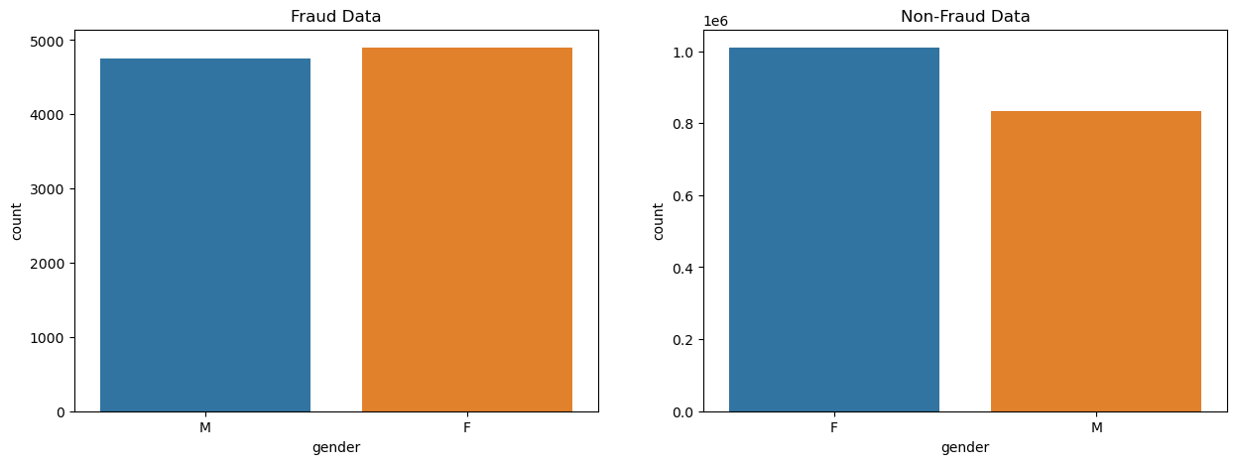
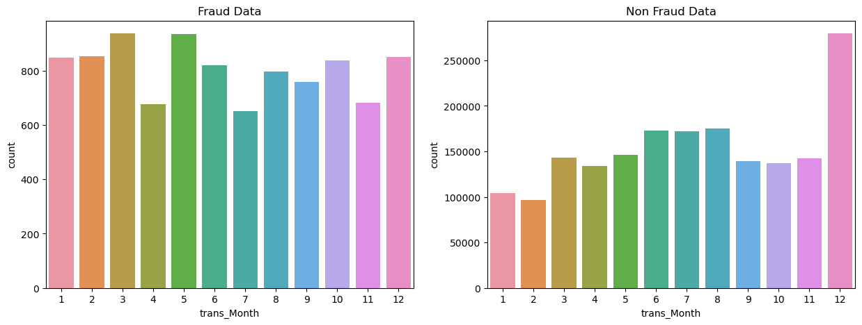
Key insights
Fraudulent transactions are higher for Female credit card holders
%age of Fraud transactions are highest in 1st, 2nd, 3rd, 5th month compared to the transactions

Slide 13
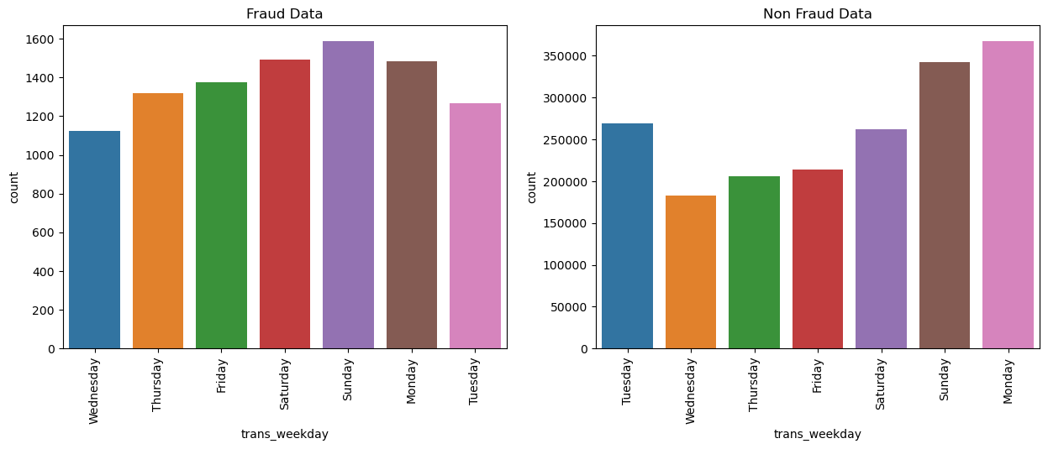
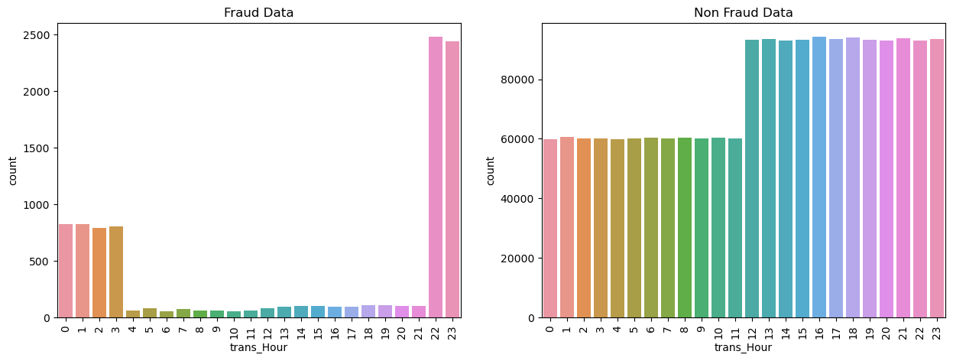
Key insights
Count of transactions are higher on Weekends and Monday
Fraudulent transactions are higher at odd hours between 22:00 to 03:00

Slide 14
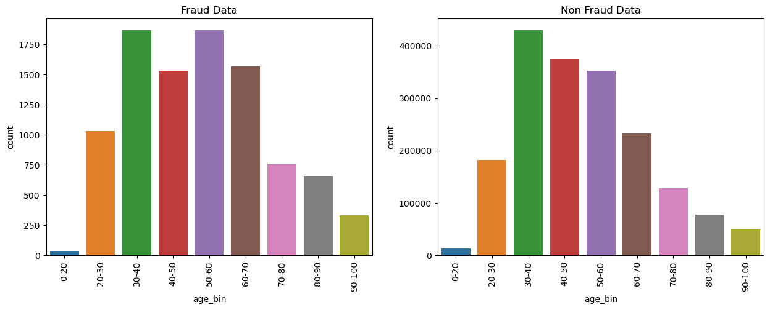
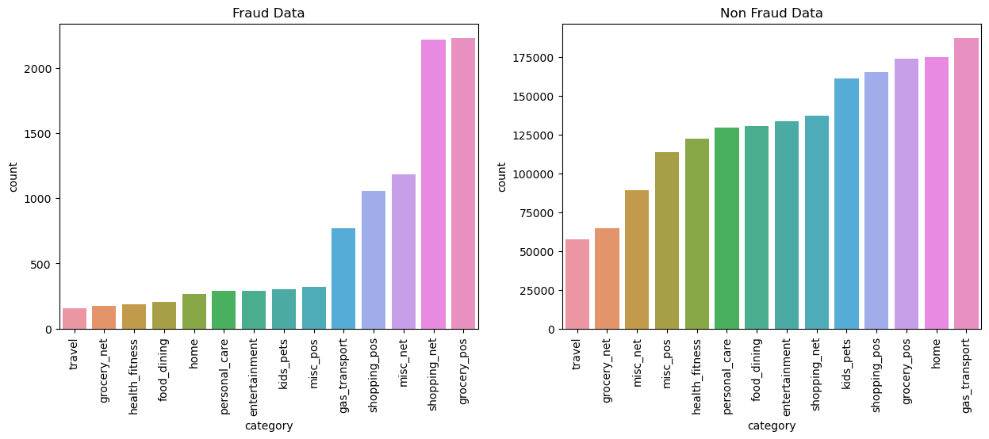
Key insights
Count of Frauds transactions are more on credit card holder's age group of 20 to 60
Count of Frauds transactions are more on credit card holder's age group of 50 to 60 where as count of normal transactions is less in them
Fraudulent transactions are more at grocery_pos, shopping_net, misc_net, shopping_pos, gas_transport Categories
shopping_net where count of normal transaction is less.
Frauds transactions is slightly less in gas_transport, shopping_pos where count of normal transaction is more.

Slide 15
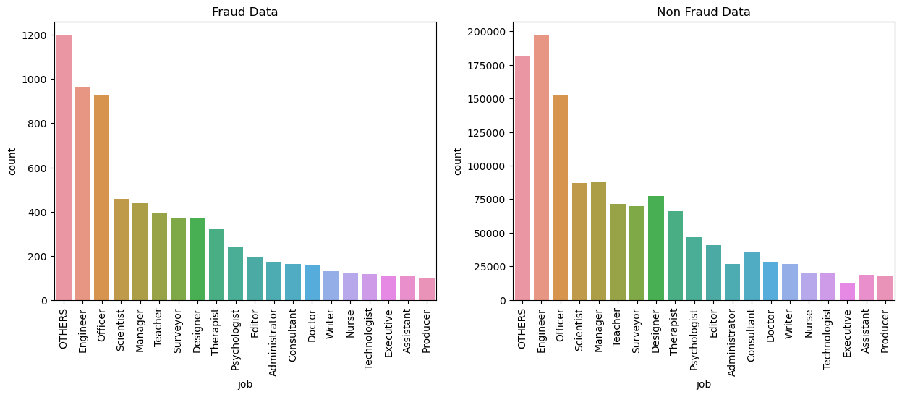
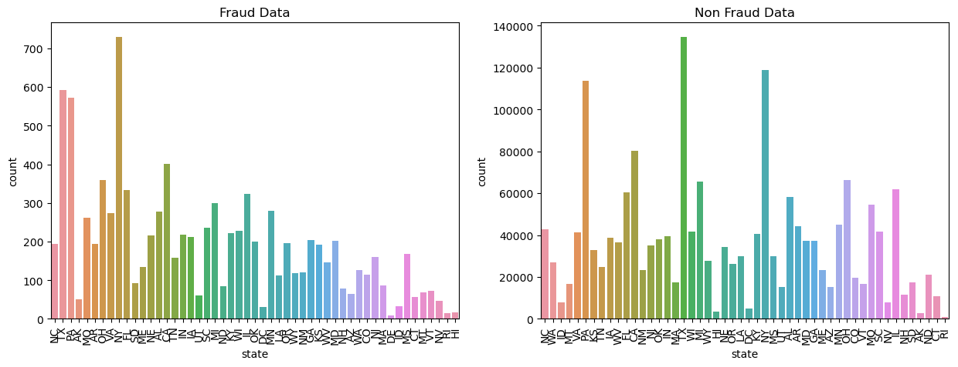
Key insights
Engineers, Officers and other categories have more fraudulent transactions
Frauds transactions are more in NY, TX and PA States.
More in South , Midwest and lower in West and Northeast States.

Slide 16
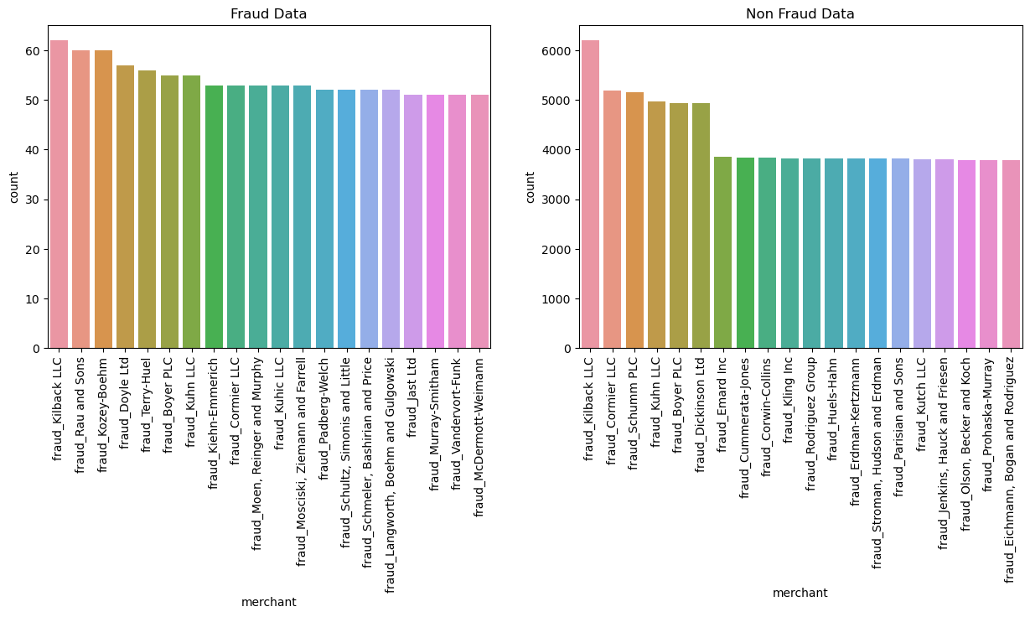
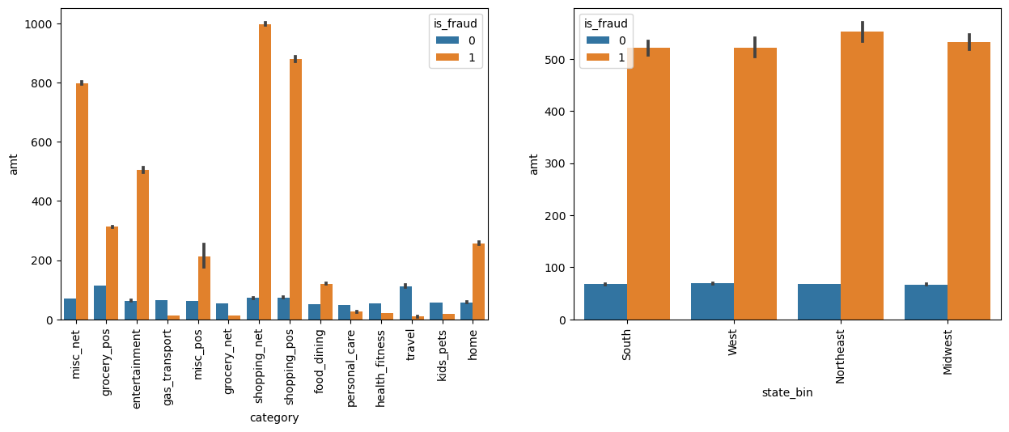
Key insights
Frauds transactions are more for fraud_Kilback LLC, fraud_Rau and sons, fraud_Kozey.Boehm merchants.
The maximum amount spend for fraud transactions were on shopping_net, shopping_pos, misc_net category.
The maximum amount spend for fraud transactions were at Northeast region.

Slide 17
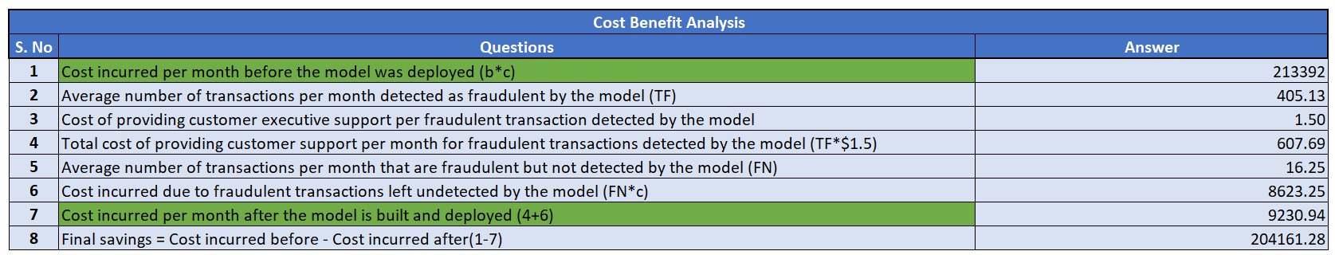
Cost Benefit Analysis
Before Cost incurred/month by the bank= $ 213392.2204
Now Cost incurred/month by bank after modelling =$ 9230.94 only

Slide 18
Conclusion
For comparable amount spent in last 24hrs v/s past spent data gets increased then its ideal for Bank to sent an SMS ALERT! to customer confirming about the transactions.
Banks need to be extra cautious and high alert on this specific days to avoid fraudulent transactions on the weekends
If bank notices the nature of amount spent is higher then regular spending pattern in such cases bank should send necessary alerts to customers.
Model predicted that major fraud transactions are occurred in the catg_home, catg_shopping_pos, catg_grocery_pos, catg_health_fitness,catg_gas_transports as these are the platform where any customer would spend large transactional amount so as fraudsters also follows the same trend. In such case its always recommended to bank to keep an eye on the track record of spend amount through FLASH SMS ALERT mentioning the detailed transaction history to respective credit card holders.
The fraud transactions are majorly done during odd hours of the day i.e. between 22 - 3 Hr so banks needs to ensure to send an SMS ALERT during such odd hours.

